Slide 1

ABFRL Brand - Generic App CTA Tags
11th Oct 2023

Slide 2
Guidelines to Implement Tagging
Adobe Launch SDK should be implemented to trigger the custom events​
​
Copy and paste the contextData as it is without changing the Camel Casing.​
​
All values should be passed in lowercase.​
​
Track State(Page Load Event) and Track Action(Non-Page Load event) should be fired along with the contextData.​
​
Context data should be fired with specific event.​
​
<> this indicates dynamic value to be captured and passed.​
​
Testing will be performed by Implementation Team after ABFRL QA team will give the confirmation/sign off for the testing done by them.​
​
UAT should be done first in staging and then in production post-production UAT adobe’s codes are pushed to live.​
​
Product Category value should be consistent for every product for entire website.​
​
For Customer ID, pass the value only when available else pass it as blank.

Slide 3
Super App Brands
Since Super App contains multiple cross-brands journey, therefore w.r.t to tracking the brand/product brand currently included( along with the value to be passed in the contextData key)
Brand/Product Brand | Context Data Value
Van Huesen | vh
Peter England | pe
Allen Solly | as
Louis Phillipe | lp
Reebok | reebok
American Eagle | aoe
Forever 21 | f21
Simon Carter | sc

Slide 4

Generic

Slide 5
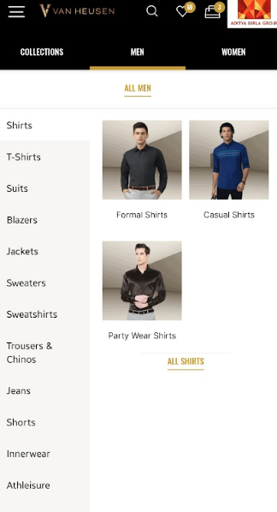
On menu click

Slide 6
Click Type | Tracking Type | Launch variables | Expected Values | UAT Status
Menu tracking | All CTAs | let contextData={ linkName : “<cta name>", channel: "<android/ios>|<page name without word page from which menu is clicked, // eg : home, category,etc. customerID : "<customerID>", // only pass when available linkPageName: "<page name>", //the name of the page from where the product was clicked, eg : home page, product listing page , etc. loginStatus : "<logged-in/guest>" , brand: "<brand name>", menuNav: “<level1:level2:level3>”, platform: "<android/ios>", userDetails: "<gender>|<age>", // pass only when user is logged in dob: "<date of birth>" // pass only when user is logged in }; ACPCore.trackAction(“<cta name>", contextData); //for brand expected values, refer to slide no. 3 | loginStatus may have the values:- logged-in guest <ctaName> will be the menu option clicked, eg: Polo Tshirt, men, accessories In menuNav, the expected values will be like Level1- when user clicks on collection, men, women, sale, etc, then menuNav value will be:men, women, sale Level2- when user clicks on shirt tshirts, suits, accessories, etc then menuNav value will be: men:shirts Men:wallets Level3- when user clicks on casual shirt, formal blazers, socks, etc then menuNav value will be: men:suits:formal suits men:shirt:casual shirt

Slide 7
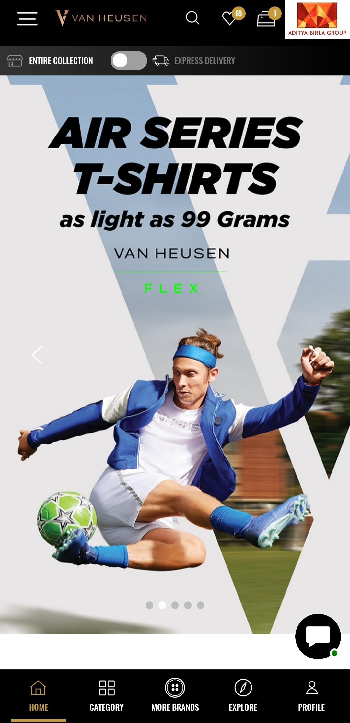
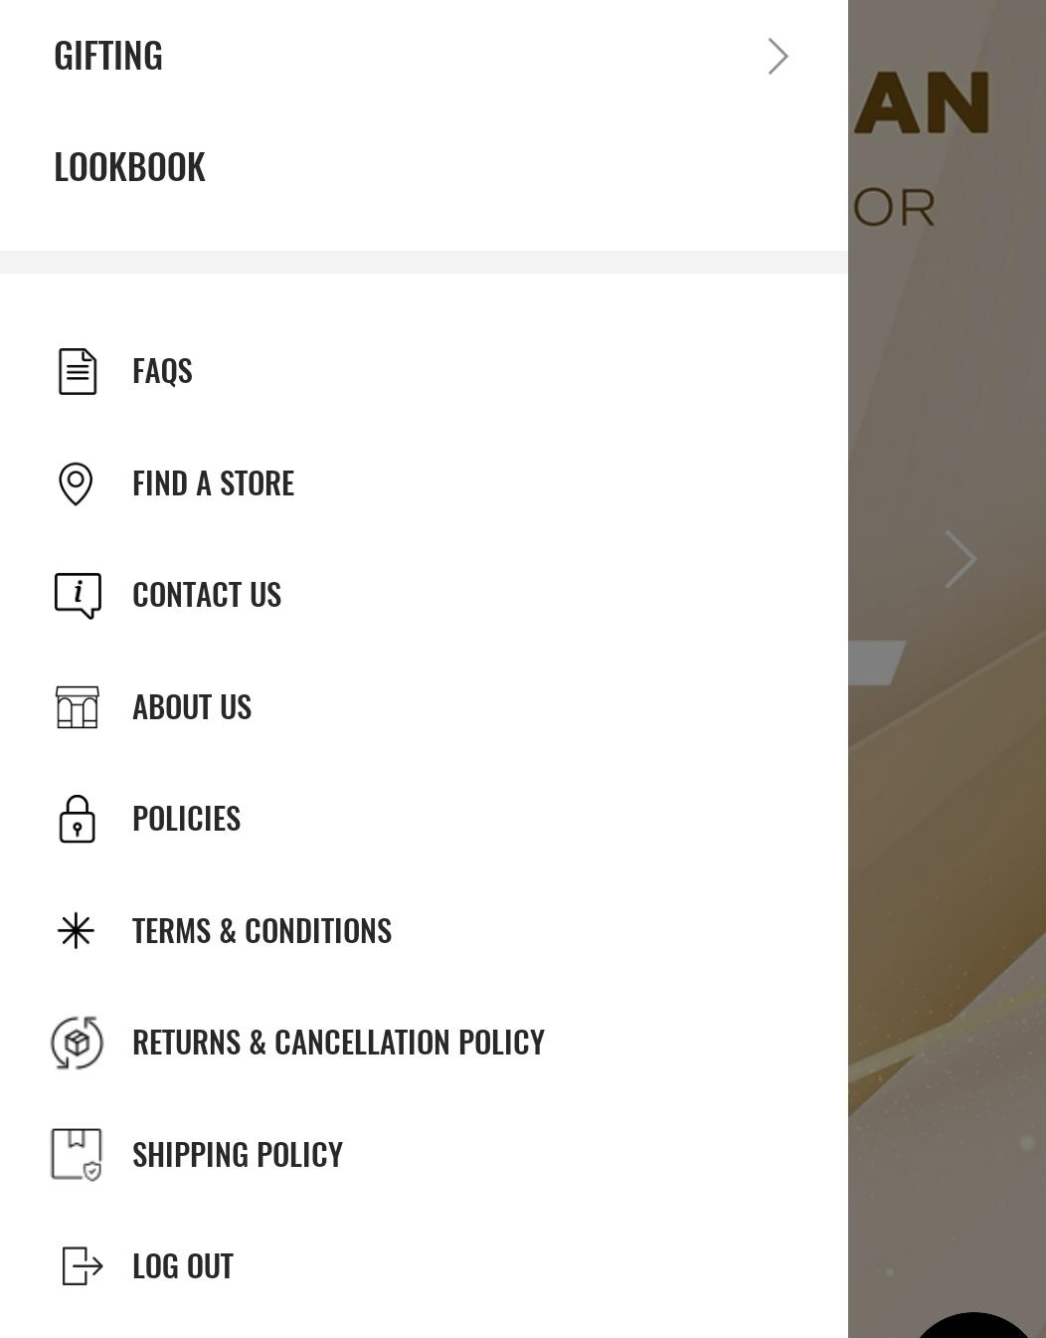
On footer cta click

Slide 8
Click Type | Tracking Type | Launch variables | Expected Values | UAT Status
Footer click | All CTAs | let contextData={ linkName : “<cta name>", channel: "<android/ios>|<page name without word page from which cta is clicked, // eg : home, category,etc. customerID : "<customerID>", // only pass when available linkPageName: "<page name>", //the name of the page from where the cta was clicked, eg : home page, product listing page , etc. loginStatus : "<logged-in/guest>" , brand: "<brand name>", platform: "<android/ios>", userDetails: "<gender>|<age>", // pass only when user is logged in dob: "<date of birth>" // pass only when user is logged in }; ACPCore.trackAction(“<cta name>", contextData); //for brand expected values, refer to slide no. 3 | loginStatus may have the values:- logged-in guest

